Slide 1

Elephant Management System
This innovative system offers comprehensive tools to manage elephant care, health, and welfare, ensuring a thriving environment for these magnificent creatures. The system caters to zoos, sanctuaries, conservation organizations, and researchers, empowering them to optimize elephant well-being.

Slide 2
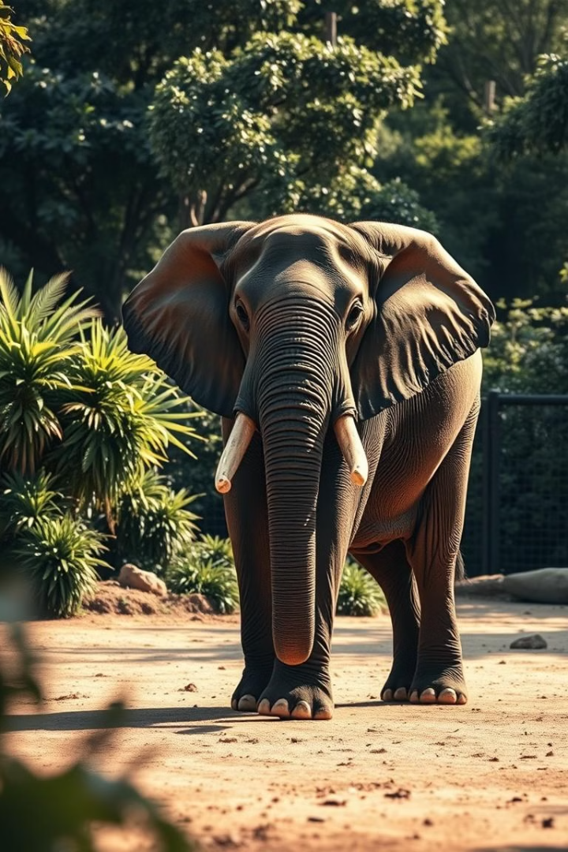
Target Audience and Problem Solved
The Elephant Management System directly benefits elephant caretakers, veterinarians, and researchers, streamlining daily operations and facilitating data-driven decision-making.
Improved Efficiency
The system automates routine tasks like feeding schedules and health record management, freeing up valuable time for caretakers.
Enhanced Collaboration
The system fosters seamless communication and collaboration among teams, leading to more efficient and coordinated care.
Data-Driven Insights
Comprehensive data analysis provides valuable insights into elephant behavior, health trends, and environmental factors, guiding optimal care strategies.
Increased Transparency
Transparent record-keeping and data accessibility promote accountability and responsible management practices.

Slide 3
Core Technologies
The Elephant Management System leverages a robust technology stack to deliver a comprehensive and efficient solution.
Java Swing
MySQL
Figma
The desktop application's user interface is built with Java Swing, known for its rich graphical components and cross-platform compatibility.
The system relies on MySQL for secure and efficient data storage, ensuring data integrity and scalability.
Figma is used for UI/UX design, enabling intuitive and user-friendly interfaces for both the desktop application and website.

Slide 4
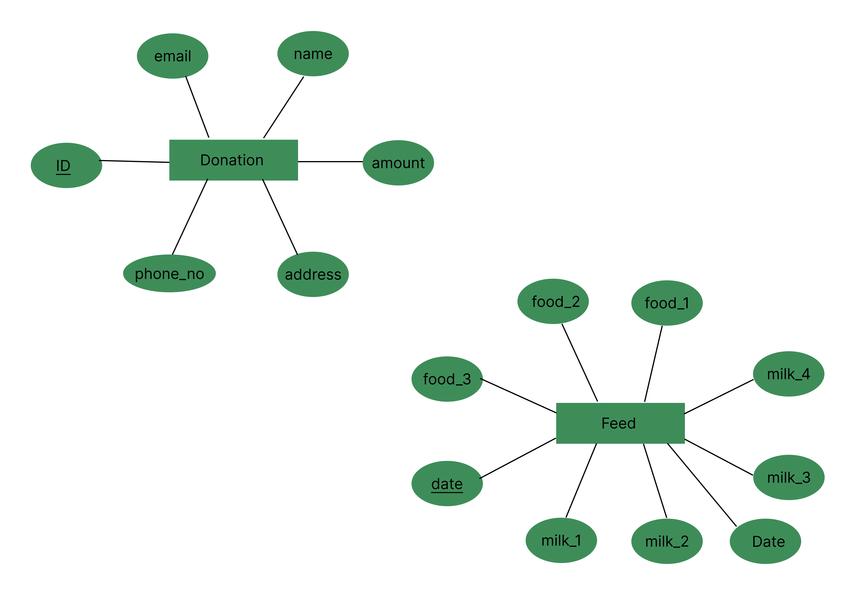
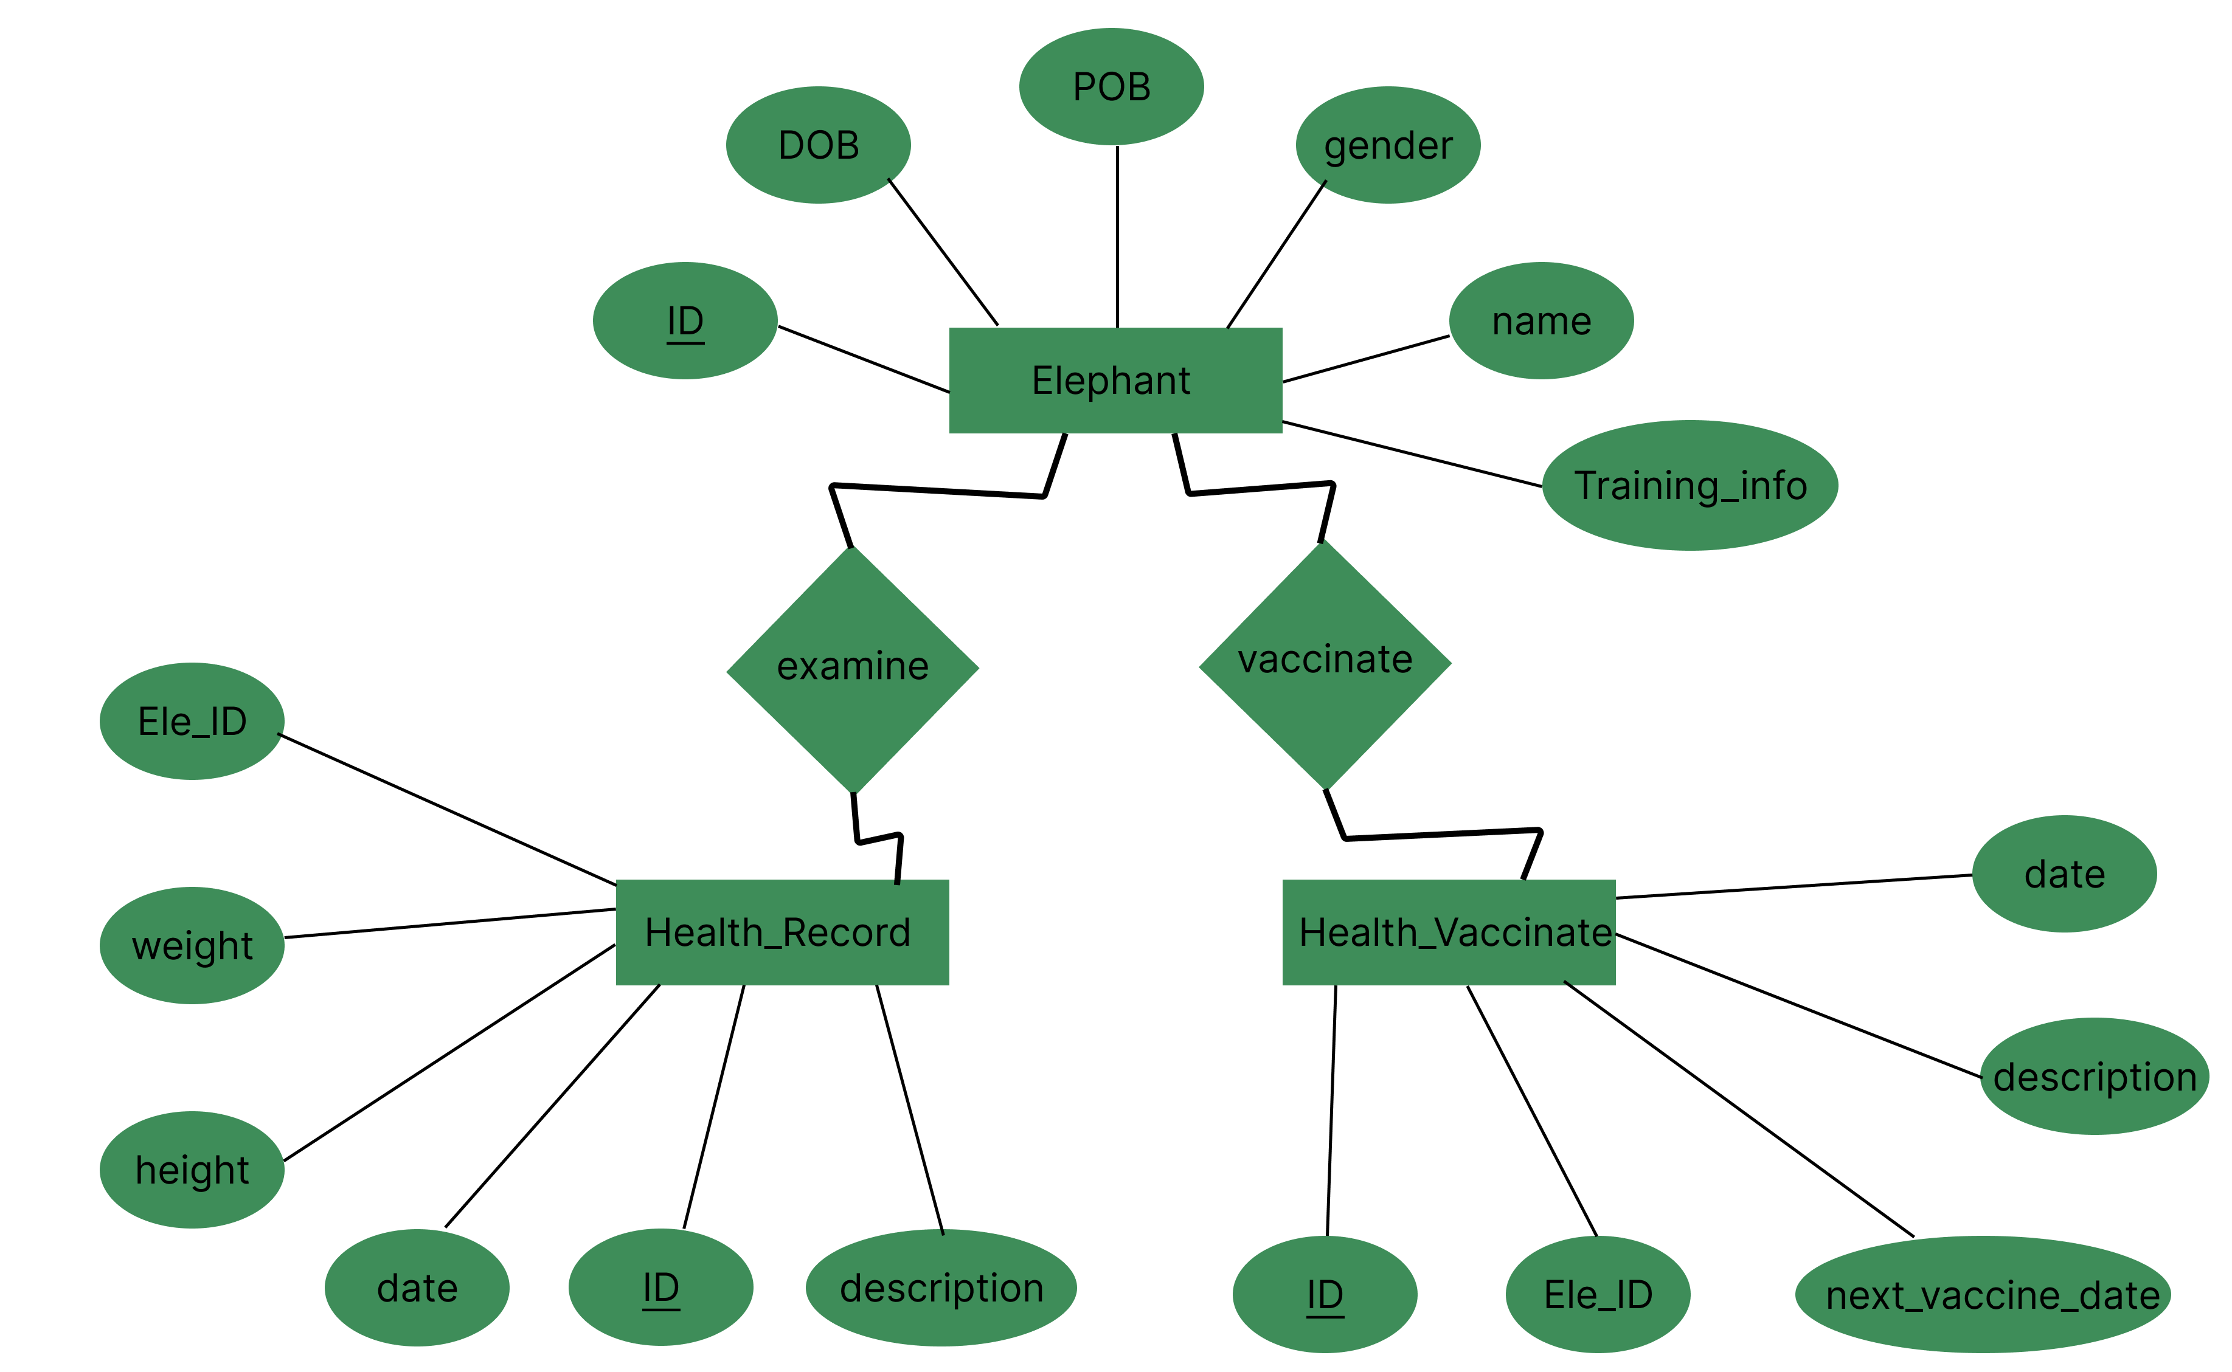
ER DIAGRAM

Slide 5

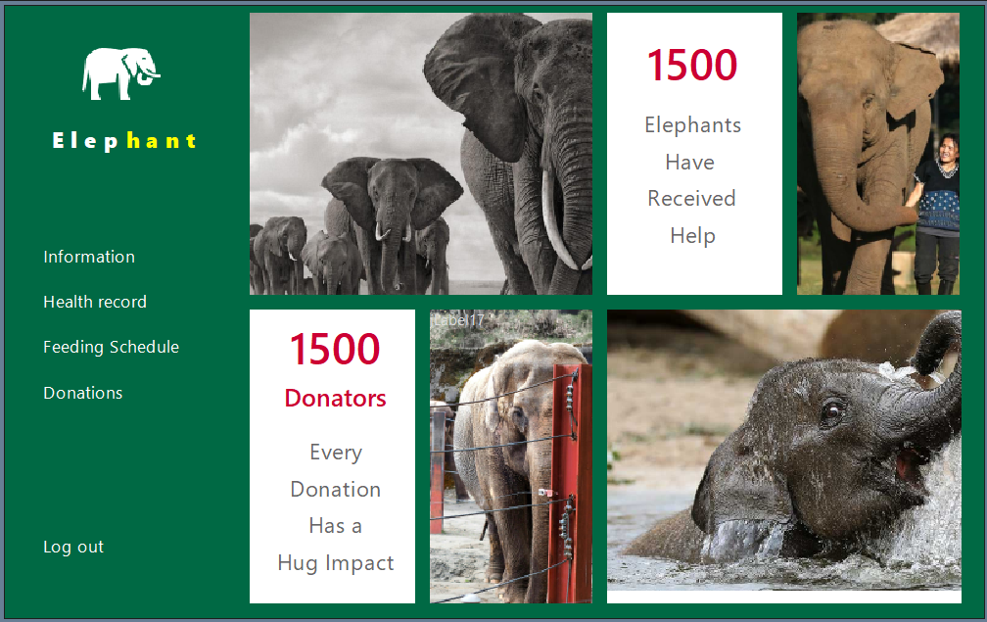
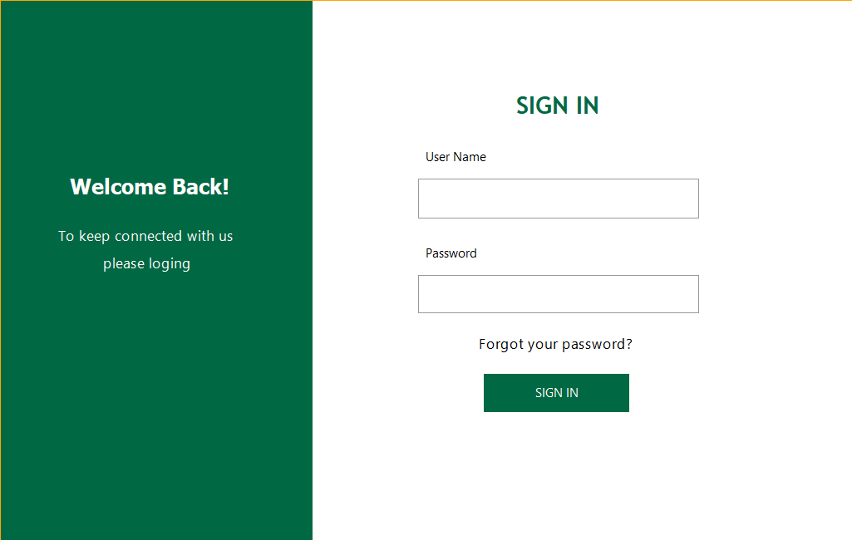
Desktop Application Interface
The desktop application provides a centralized hub for managing various aspects of elephant care.
1
information
Add elephants, delete elephants, update details of elephants and upcoming events.
2
Health Records
This module allows for detailed record-keeping of each elephant's health history, including medical records, treatments, and vaccinations.
3
Feeding Schedules
The system automates the creation and management of feeding schedules, ensuring consistency and nutritional balance.
4
Donations
Track and manage donations received, promoting transparency and accountability in financial management.

Slide 6
START PAGE
LOGIN PAGE
DASHBOARD
INFORMATION
HEALTH RECORDS
FEEDING SCHEDULE
DONATION
SHOW ELEPHANT RECORDS
TODAY’S VACCINES
ADD HEALTH DETAILS
ADD ELEPHANTS
ADD VACCINE DETAILS
UPDATE ELEPHANT’S DETAILS
DELETE ELEPHANTS

Slide 7
video

Slide 8
Website Interface

Slide 9





Benefits of the Elephant Management System
The Elephant Management System offers numerous advantages for elephant care and conservation efforts.
Improved Health
The system promotes proactive health management, leading to early detection of issues and timely interventions.
Enhanced Welfare
The system optimizes care routines, reducing stress and promoting a more natural environment for elephants.
Increased Transparency
The system fosters transparency in elephant care practices, building trust with stakeholders and promoting accountability.
Data-Driven Decision-Making
The system provides valuable data insights, guiding researchers and caretakers towards evidence-based decisions.

Slide 10

Conclusion
The Elephant Management System represents a significant advancement in elephant care, offering a comprehensive solution to improve welfare, enhance research, and facilitate collaborative efforts towards elephant conservation.
Sustainability
Impact
The system promotes sustainable practices, ensuring long-term well-being for both elephants and the ecosystems they inhabit.
The system has the potential to significantly impact elephant conservation efforts globally, promoting best practices and raising awareness.

Slide 11
Questions

Slide 12



Group 16
SC/2021/12446
SC/2021/12
PATHUM
SC/2021/
CHAMIKA
W. M. U. T. WANNINAYAKA
SC/2021/
PRIYANIDU
SC/2021/
NIMANTHA
SC/2021/
NETHMI

Slide 13
THANK YOU

